Slide 1
Introducing:
Grub Grabber
Isaac Jordan, Jack Croal,
Callum Nixon, Ben Jackson
Group A4

Slide 2
Aim
To provide an application that is accessible to all online which provides users with personalised recommendations for places to get food.

Slide 3
Main Features
Immediate food location recommendations, whether or not you have signed up.
Takes into account what other people have rated if you are similar users (like the same places).
Uses familiar Google Maps API to provide directions and maps.
Provides links to menus, and price lists.

Slide 4
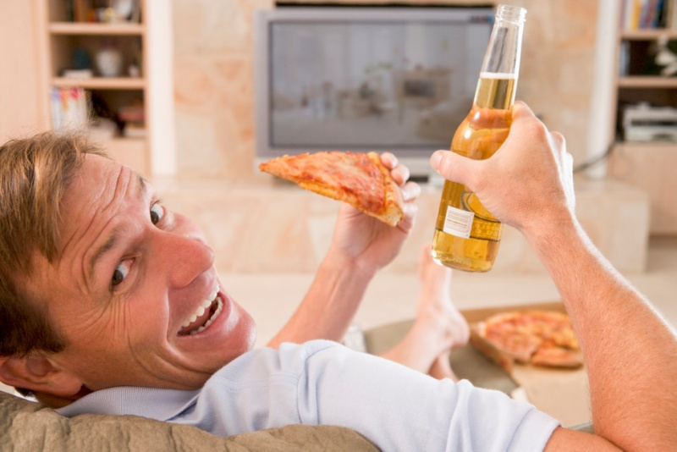
Persona – Steven Jacobs
25 years old
PHD student studying philosophy
Lives in Glasgow
Single and doesn’t have many friends
“I can’t be bothered setting up any accounts”
“I love a cheeky Nandos”
- Steve’s studies take up a lot of his time so when he has time to eat lunch he will want it to be quick to get and eat.
- Having lots of spam emails already filling up his inbox, Steve does not want to give his information away to another website.
- Steve generally only eats vegetables on special occasions, and happily eats unhealthy food if it saves him time and money.
- Being a student, money can be tight, so being able to find the cheapest places to eat nearby would make his life easier.

Slide 5
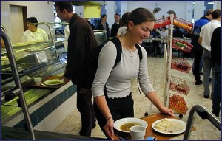
Persona – Harriet Cole
23 years old
Recently graduated into an office job
In long distance relationship
Big foodie
Lives in London
Loves social media
“I don’t eat the same cuisine 2 days in a row”
“Presentation really makes a good dish great!”
Harriet works in a boring office, her lunch is at the same time every day. She wants daily food suggestions on time every day.
Due to expensive house prices she tries to save what money she can, however this doesn’t stop her spending money on nice, varied food once in a while.
Harriet eats out for lunch every day she is working but being in a new city struggles to find the right place for her to eat as she enjoys eating a variety of cuisines.
She’s a big Facebook user, so obviously doesn’t care about giving her personal information away by registering for Food Finder.

Slide 6
Specification
Takes location (street/postcode) from user if they don't have an account.
Recommends places based on ratings and location in relation to user.
Gives information on the recommended place based on Google Maps API (reviews, menu, pricelists).
Stores a log of decisions (favourite, eat, dismiss, blacklist) made by the user in order to make sure places they don’t like don't come up again, and that they don't get the same places too many times in a few days.
Users can create an account to store preferences and locations.

Slide 7
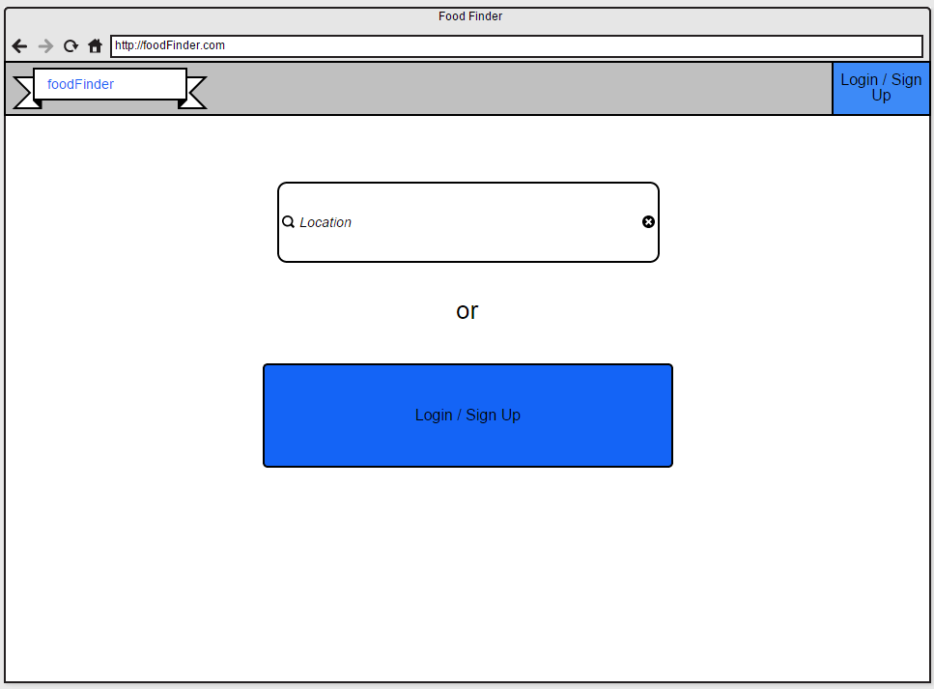

Slide 8
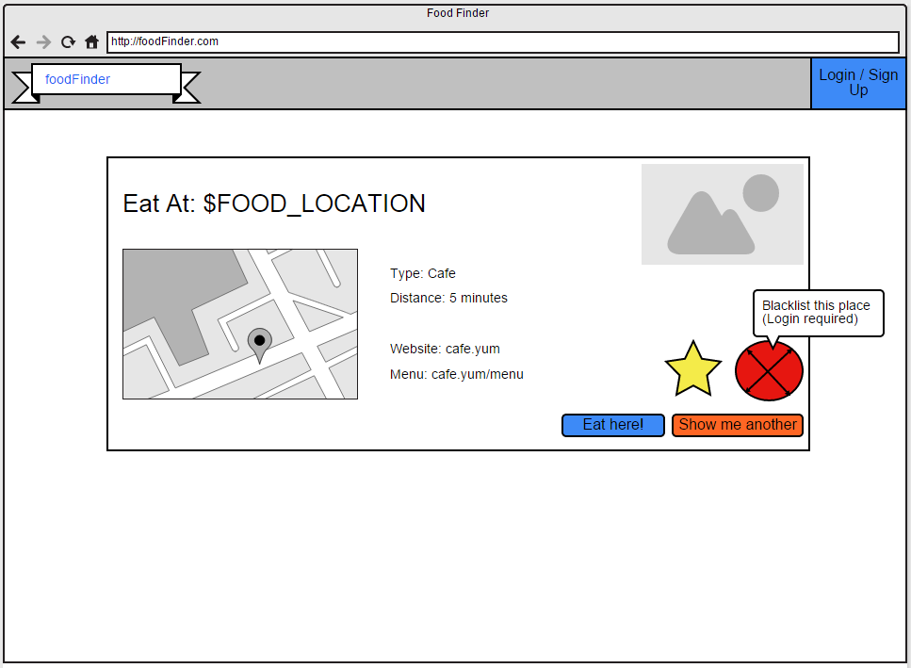

Slide 9
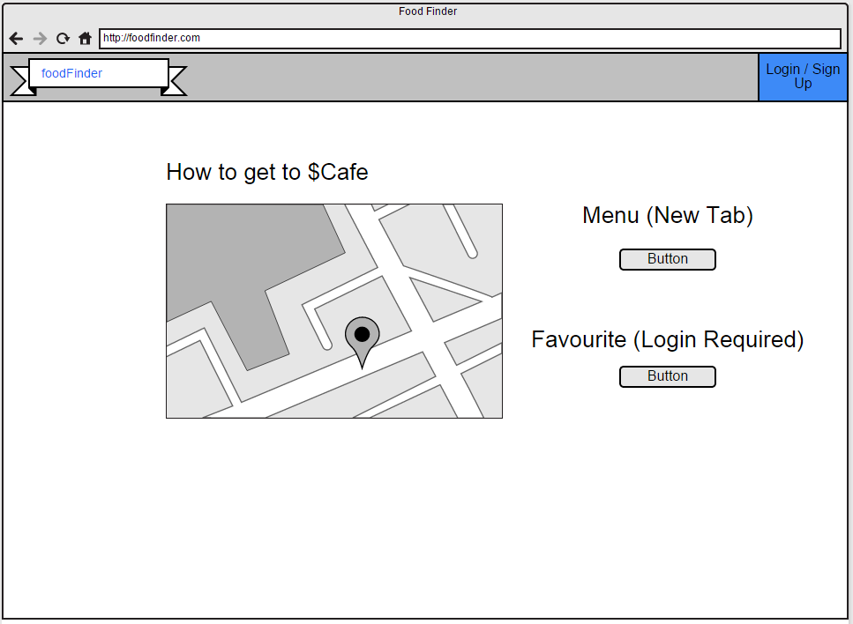

Slide 10
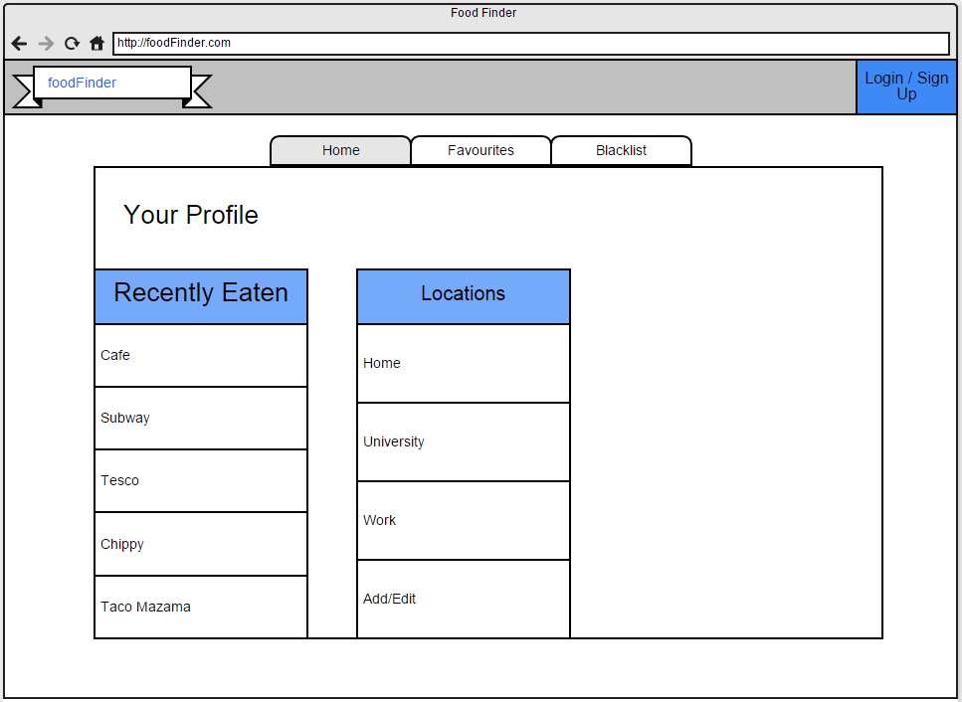

Slide 11
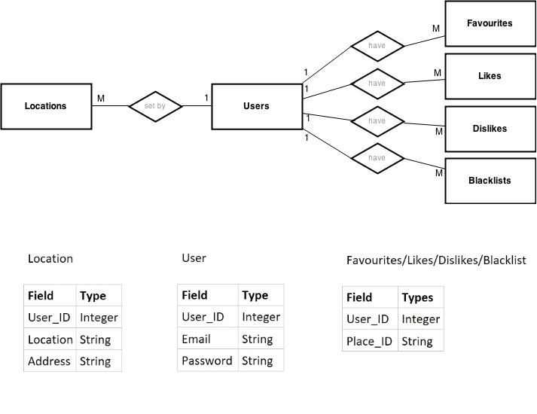
Entity-Relationship Diagram

Slide 12
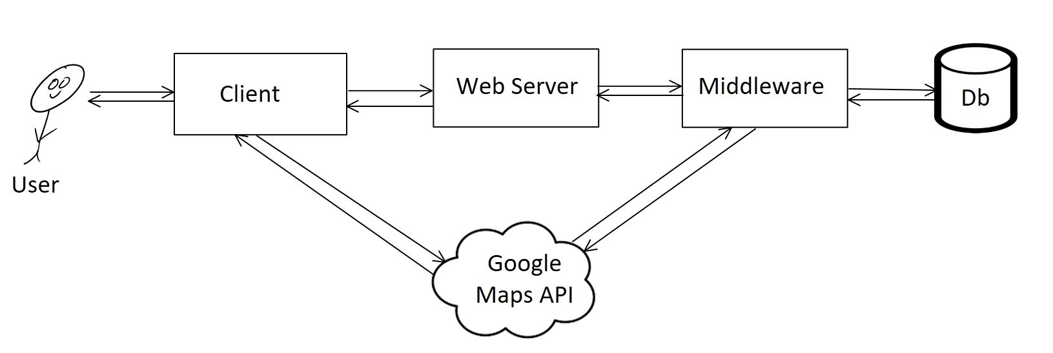
System Architecture

